Slide 1
GBARAN PU
2022/2023 DIY CATALOGUE

Slide 2
DIY Sectional Replacement of Defective Etelebou FS Power Cable - Sep 2023 ($10k)
BACKGROUND
Etelebou FS was originally being powered by gas and diesel generators as a stand alone flow station. This had negative impact on GHG, diesel and maintenance cost. In 2017, power was routed from the Manifold to the Flow Station until Jun 2023 when unfortunately, there was a power outage as a result of a damaged cable. The Sumo pump which supplies water to the station attendants was affected amongst other equipment making things difficult their survival with truck water supply from FLB as mitigation.
WHAT THE TEAM DID
The team investigated and identified cable damage source, utilized already available materials at the warehouse and leveraged on team expertise to rectify the issue.
BUSINESS VALUE
$10,000 cost savings from vendor mobilization and work execution.
Eliminated “Kilometers Driven” for water tanker supply to Etelebou facilities

Slide 3
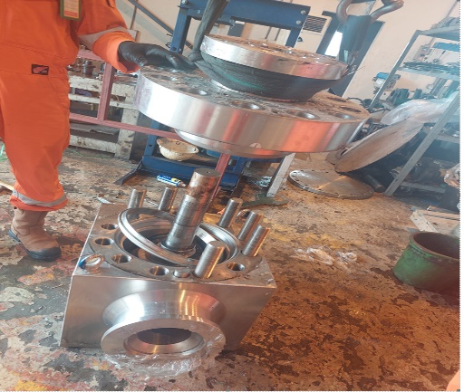
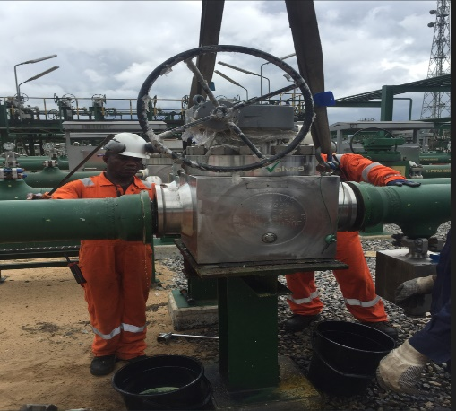
Unlocking 130MMScf/d through KOCR43T Valve DIY Repair - Aug 2023 ($55k)
BACKGROUND
Opportunity to maximize production from Kolo Creek to Gbaran and Soku arose with the operationalization of K2G and Soku-Sanbarth commissioning. This was however hindered due to KOCR43T unavailability as a result of bonnet seep from an 8inch class 10k psi manual isolation valve
WHAT THE TEAM DID
Option of mobilizing maintenance execution vendor was considered due to the required work complexity as the valve was designed for HPHT wells, with the demerit of taking days to scope and securing budget approval before execution mobilization.(deferment and vendor mobilization cost)
Joint team of Mechanical, Operation and Logistics took up the challenge; carried out in-depth planning for safe execution utilizing the concept of FWE.
Re-kitting Of Failed Valve in the PU Production Maintenance Workshop
BUSINESS VALUE: Visible contribution to Shell Spiralling-Up aspiration by
Unlocking 130MMScf/d gas and circa 10kbbls/d liquid
$55,000 cost savings from vendor mobilization, work execution and purchase of new valve
Capacity development opportunity for PU personnel
Re-kitted Valve being re-instated to service

Slide 4
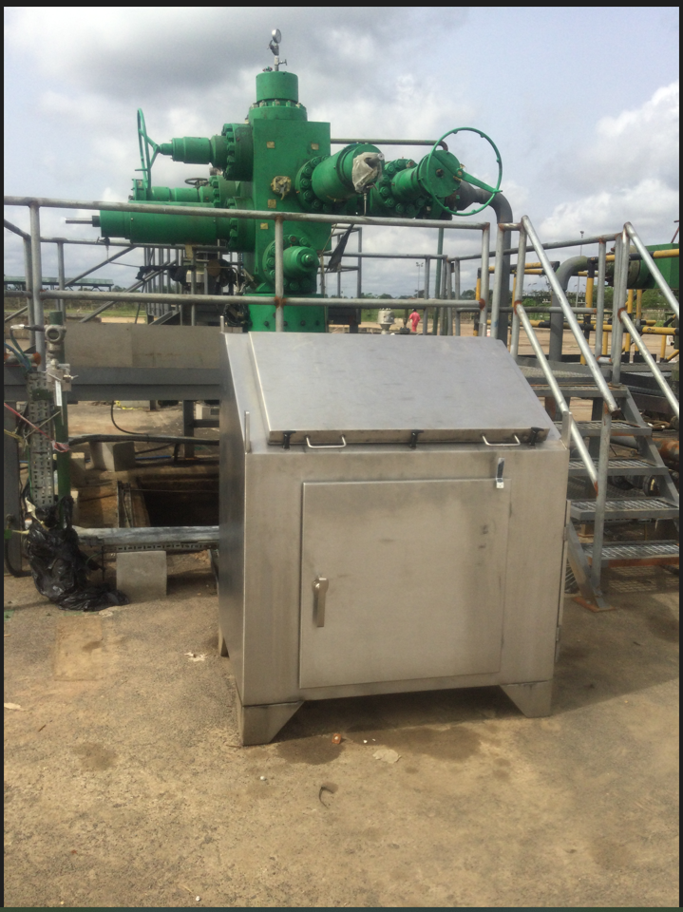
Resolution of GBAR028T Frequent Trips through DIY – Jul 2023 ($7.5k)
BACKGROUND
GBAR028T has been tripping on wellhead control panel failure on different occasions in the past days causing deferments. The Gbaran wellhead team carried out extensive troubleshooting and discovered bad regulator on panel.
WHAT THE TEAM DID
The team repaired the faulty components on regulator, installed it in control panel utilizing in-house resources as against mobilizing CWI team to carry out activity and well commissioned ok in auto mode.
BUSINESS VALUE
• Cost savings in buying a new regulator ($1,500) and mobilizing CWI team ($6,000) • Production deferment of 45MMscf/d and 3Kbbl of condensate

Slide 5
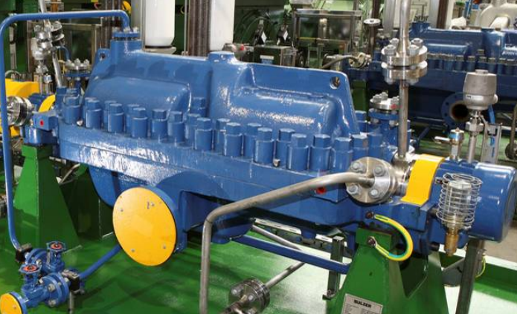
Main Oil Export Pump B&C Repair through DIY – March 2023 ($100k)
BACKGROUND
Train one Export pumps have had sub optimal performance post CaCO3 de-scaling of 2021.These export pumps have seen Incessant trips on high pump casing vibration
Sulzer vendor invited for scoping alone charged 5000 USD . Actual repair cost circa 100,000.00 USD based on Vendors proposal was factored into OP22 MRTA CAPEX portfolio
On 11th January & 27th March 2023 , Asset mechanical team after a deep dive on the issue, understood the possible root causes and got asset leaderships approval for an in-house fix for pumps B & C respectively.
WHAT THE TEAM DID
Mechanical team took up the challenge, carried out an intrusive inspection on the unit, identified and rectified the fault.
Corrected all observed causes of unbalance, including repairing & replacing of identified loose rotor components and confirming clearances.
Scrapping off of all observed calcium carbonate deposits on impeller crevices
Replacement of failed DE & NDE bearings
Re-kitting and re-instating of Mechanical seals
Re-confirmed alignment and commissioned unit.
BUSINESS VALUE
Zero LTI - Safe activity execution.
Restored Technical Integrity and availability of pumps B & C for liquid production of circa 30kbopd (with Vibration values normalized)
Cost savings of circa $100,000
Great Learning for the rest of the team

Slide 6
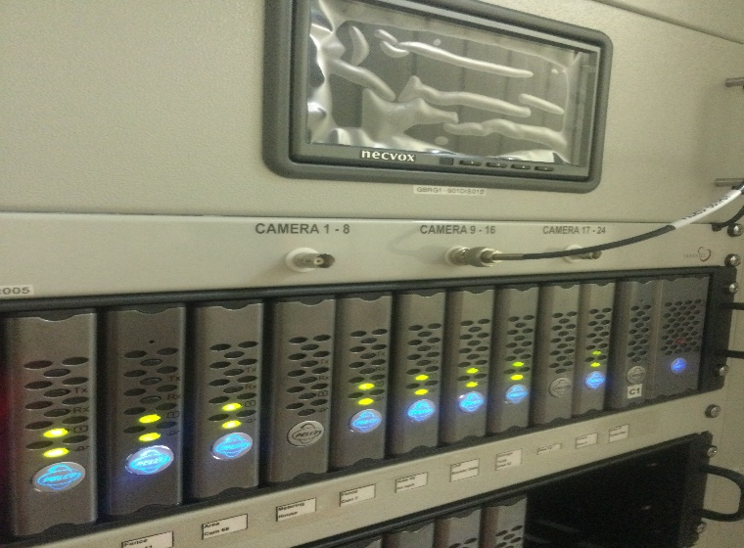
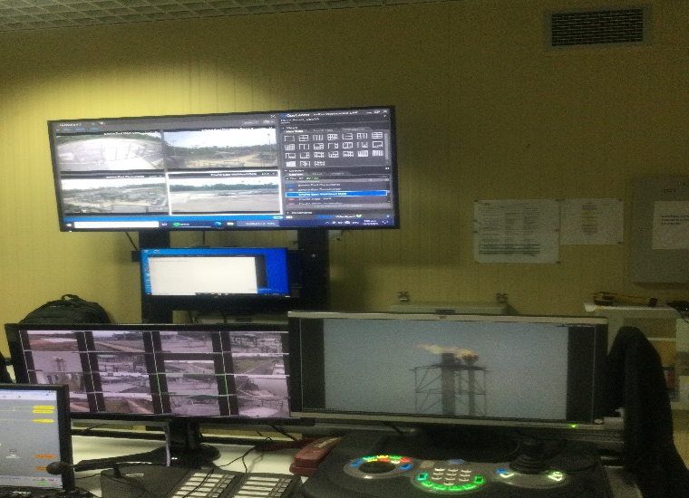
Gbaran CCTV System Restoration through DIY – March 2023 ($58k)
BACKGROUND
All CCTV Cameras in Gbaran CPF failed to function and were observed to be offline on the CCTV display unit.
The following critical services were impacted:
Viewing all and especially critical areas of the CPF and its perimeter to ensure that safety barriers were maintained, and unauthorized access were mitigated.
Real-time recording and storage of events for audit, investigation, and fact-finding purposes.
Effective surveillance of site by security personnel from Security Control Room.
Failed unit/system could, not be replaced by vendor
Restored Fibre Optics power unit at CPF
WHAT THE TEAM DID
Gbaran Telecoms team commenced repair of these systems when support for the version of CCTV’s was not forthcoming. They employed in-house expertise and skills.
The team carried out troubleshooting, identified the Optic Fiber receiver power equipment at CCR and AG Booster FAR as the faulty devices.
They carried out onsite analysis, troubleshooting, repairs, integration of all cameras to CCTV network and commissioning of the devices thereby restoring the system.
The first batch of cameras were restored in January 2023 and the last batch restored most recently in March 2023.
Full functionality of systems are confirmed after 72 hours of test. .
Gbu Control room CCTV display Unit
BUSINESS VALUE
Zero LTI - Safe activity execution and Speedy recovery.
Prevention of potential safety exposures:
Avoidance of ineffective surveillance due to absence of site overview by Gbaran Security personnel.
Elimination of inability to have real-time event recording and storage for audit purposes.
Cost Savings: Specialist contractor mobilization ($45,000.00) and optic Fiber Receiver power equipment procurement ($13,000.00).

